Slide 1
Introduction to IEEE 802.11 Protocol
DR. MUID MUFTI
ID TECHNOLOGIES
ISLAMABAD

Slide 2
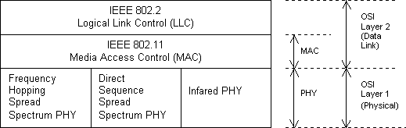
What 802.11?
802.11 is an IEEE standard for MAC and Physical Layer for Wireless Local Area Network (WLAN).

Slide 3
Why Standard?
Multi Vender inter operability
Protects customer investment
Economies of scale

Slide 4
Why not Wireless Ethernet?
Ethernet is simple, widely used, cheap ...
But
Collision Detection
  Not possible in wireless
  Would require a full duplex radio
  Receiver sensitivity
Carrier Senses
  Hidden Stations
Mobility
Power Save

Slide 5
802.11 Versions
802.11 - 1997
  Maximum data rate: 2Mbps
  2.4Ghz band
  Indoor Range: 20 meters
  Outdoor Range: 100 meters
  Wide range of Physical layers
802.11a - 1999
  Maximum data rate: 54Mbps
  5.1 - 5.8Ghz band
  Indoor range: 35 meters
  Outdoor range: 120 meters
  54 Mbps

Slide 6
802.11 Versions
802.11b - 1999
  Maximum data rate: 11Mbps
  2.4Ghz band
  Indoor Range: 38 meters
  Outdoor Range: 140 meters
  11 Mbps
802.11g - 2003
  The current industry adopted specification
  Maximum data rate: 54Mbps
  2.4Ghz band (backwards compatible with 802.11b)
  Indoor range: 38 meters
  Outdoor range: 140 meters
  54 Mbps

Slide 7
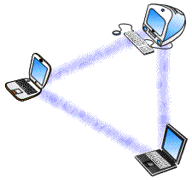
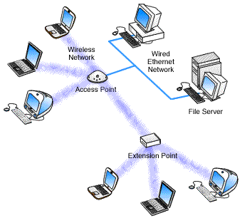
Operating Modes
Adhoc Network
Adhoc Nework
Infrastructure Network
Infrastructure Network

Slide 8

What is WiFi?
A trademark of the Wi-Fi Alliance
Founded in 1999 as WECA (Wireless Ethernet Compatibility Alliance).
More than 300 companies
WiFi certification warrants interoperability between different wireless devices
Ensures correct implementation IEEE 802.11
Tests the wireless components to their own terms of reference

Slide 9
Basic Service Set (BSS)

Slide 10


Extended Service Set (ESS)
Distribution System
Portal

Slide 11
Services
Station services:
  authentication,
  de-authentication,
  privacy,
  delivery of data
Distribution Services
  association
  disassociation
  reassociation
  distribution
  Integration

Slide 12
MAC
MEDIUM ACCESS CONTROL

Slide 13
Medium Access Control
Functionality
Reliable data delivery
Fairly control access
Protection of data
Deals with
Noisy and unreliable medium
Frame exchange protocol - ACK
Hidden Node Problem – RTS/CTS
Participation of all stations
Reaction to every frame

Slide 14
Coordination Functions
Distributed Coordination Function (DCF)
  Medium access is contended by all the members of the network
Point Coordination Function (PCF)
  Access Point is solely responsible for medium access

Slide 15
MAC Mechanism
Retry Counters
  Short retry counter
  Long retry counter
  Lifetime timer
Basic Access Mechanism
  CSMA/CA
  Binary exponential back-off
  NAV – Network Allocation Vector
Timing Intervals
  SIFS, Slot Time, PIFS, DIFS, EIFS

Slide 16
CSMA/CA
Physical Carrier Sense
Virtual Carrier Sense
  Network Allocation Vector (NAV)

Slide 17
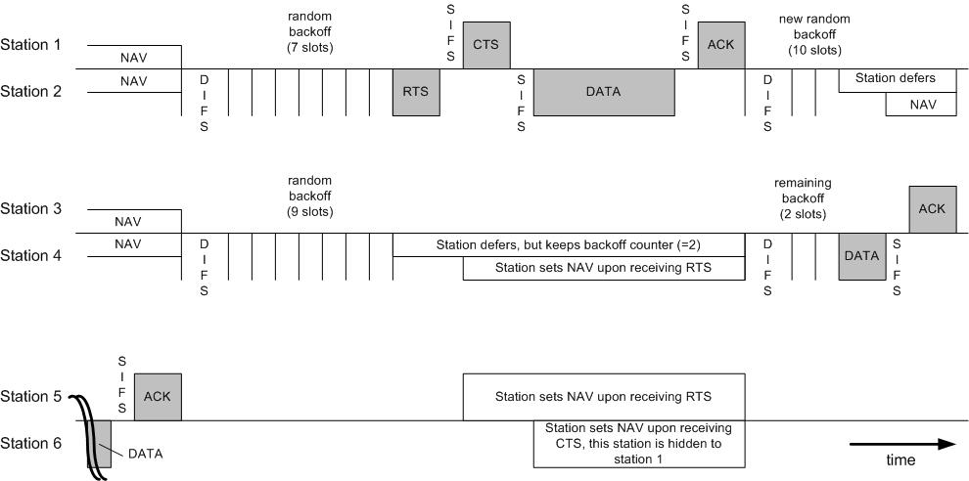
DCF Operation

Slide 18
PCF Operation
Poll – eliminates contention
PC – Point Coordinator
  Polling List
  Over DCF
  PIFS
CFP – Contention Free Period
  Alternate with DCF
Periodic Beacon – contains length of CFP
CF-Poll – Contention Free Poll
NAV prevents during CFP
CF-End – resets NAV

Slide 19
Frame Types
NAV information
Or
Short Id for PS-Poll
Upper layer data
2048 byte max
256 upper layer header
FC
Duration
/ID
Address
1
Address
2
Address
3
Sequence
Control
Address
4
DATA
FCS
2 2 6 6 6 2 6 0-2312 4 bytes
Protocol Version
Frame Type and Sub Type
To DS and From DS
More Fragments
Retry
Power Management
More Data
WEP
Order
IEEE 48 bit address
Individual/Group
Universal/Local
46 bit address
MSDU
Sequence Number
Fragment Number
CCIT CRC-32 Polynomial
BSSID –BSS Identifier
TA - Transmitter
RA - Receiver
SA - Source
DA - Destination

Slide 20
Frame Subtypes
DATA
Data
Data+CF-ACK
Data+CF-Poll
Data+CF-ACK+CF-Poll
Null Function
CF-ACK (nodata)
CF-Poll (nodata)
CF-ACK+CF+Poll
MANAGEMENT
CONTROL
Beacon
Probe Request & Response
Authentication
Deauthentication
Association Request & Response
Reassociation Request & Response
Disassociation
Announcement Traffic Indication Message (ATIM)
RTS
CTS
ACK
PS-Poll
CF-End & CF-End ACK

Slide 21
Other MAC Operations
Fragmentation
  Sequence control field
  In burst
  Medium is reserved
  NAV is updated by ACK
Privacy
  WEP bit set when encrypted.
  Only the frame body.
  Medium is reserved
  NAV is updated by ACK
  Symmetric variable key

Slide 22
MAC Management
Interference by users that have no concept of data communication. Ex: Microwave
Interference by other WLANs
Security of data
Mobility
Power Management

Slide 23
Authentication
Authentication
  Prove identity to another station.
  Open system authentication
  Shared key authentication
    A sends
    B responds with a text
    A encrypt and send back
    B decrypts and returns an authentication management frame.
  May authenticate any number of station.
Security Problem
  A rogue AP
    SSID of ESS
    Announce its presence with beaconing
    A active rogue reach higher layer data if unencrypted.

Slide 24
Authentication Frame Sequence
Station
AP
Authentication Request 1
(authentication Type)
Authentication Response 1
Challenge Text
Authentication Request 2
Encrypted packet
Authentication Response 2
Pass/Fail

Slide 25
Association
Association
  Transparent mobility
  After authentication
  Association request to an AP
  After established, forward data
  To BSS, if DA is in the BSS.
  To DS, if DA is outside the BSS.
  To AP, if DA is in another BSS.
  To “portal”, if DC is outside the ESS.
  Portal : transfer point : track mobility. (AP, bridge, or router) transfer 802.1h
  New AP after reassociation, communicates with the old AP.

Slide 26
Association Frame Sequence
Station
AP
Association Request
Association Response

Slide 27
Power Management
Independent BSS
  Distributed
  Data frame handshake
  Wake up every beacon.
  Awake a period of ATIM after each beacon.
  Send ACK if receive ATIM frame & awake until the end of next ATIM.
  Estimate the power saving station, and delay until the next ATIM.
  Multicast frame : No ACK : optional
Overhead
  Sender
    Announcement frame
    Buffer
    Power consumption in ATIM
  Receiver
    Awake for every Beacon and ATIM

Slide 28
Power Management
Infrastructure BSS
  Centralized in the AP.
  Greater power saving
  Mobile Station sleeps for a number of beacon periods.
  Awake for multicast indicated in DTIM in Beacon.
  AP buffer, indicate in TIM
  Mobile requests by PS-Poll

Slide 29
Power Save Timing
DTIM
DTIM
DTIM
DTIM
DTIM
Beacon
Beacon
Beacon
Beacon

Slide 30
Power Save Frame Sequence
Station
AP
Data Packet with PS=1
Sleep
Mode
PVBM bit =1
PS-POLL
Data
ACK

Slide 31
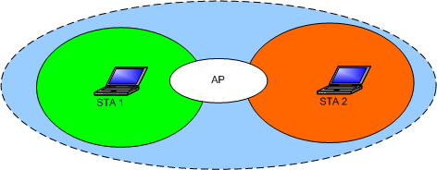
Hidden Node Problem

Slide 32
RTS CTS Frame Sequence
Station
AP
RTS
CTS
Data
ACK

Slide 33
Synchronization
Timer Synchronization in an Infrastructure BSS
  Beacon contains TSF
  Station updates its with the TSF in beacon.
Timer Synchronization in an IBSS
  Distributed. Starter of the BSS send TSF zero and increments.
  Each Station sends a Beacon
  Station updates if the TSF is bigger.
  Small number of stations: the fastest timer value
  Large number of stations: slower timer value due to collision.
Synchronization with Frequency Hopping PHY Layers
  Changes in a frequency hopping PHY layer occurs periodically (the dwell meriod).
  Change to new channel when the TSF timer value, modulo the dwell period, is zero

Slide 34
Scanning & Joining
Scanning
  Passive Scanning : only listens for Beacon and get info of the BSS. Power is saved.
  Active Scanning: transmit and elicit response from APs. If IBSS, last station that transmitted beacon responds. Time is saved.
Joining a BSS
  Syncronization in TSF and frequency : Adopt PHY parameters : The BSSID : WEP : Beacon Period : DTIM

Slide 35
Physical Layer
802.11A
OFDM

Slide 36
OFDM Transmitter
Data
Data
Preamble
Scrambler
Convolution
Encoder
Puncturer
Interleaver
Mapper
IFFT
Cylix Prefix
Pilots
Tx
Samples
Data

Slide 37
OFDM Receiver
Estimation
Cylix Prefix
FFT
Rx
Samples
Estimation
Pilots
Preamble
Deinterleaver
Depuncturer
Viterbi
Decoder
Demapper
Descrambler
Data
Data

Slide 38
Definitions IEEE 802.11a
Data rate (Mbits/s) | Modulation | Coding rate (R) | Coded bits per subcarrier (NBPSC) | Coded bits per OFDM symbol (NCBPS) | Data bits per OFDM Symbol (NDBPS)
6 | BPSK | 1/2 | 1 | 48 | 24
9 | BPSK | 3/4 | 1 | 48 | 36
12 | QPSK | 1/2 | 2 | 96 | 48
18 | QPSK | 3/4 | 2 | 96 | 72
24 | 16-QAM | 1/2 | 4 | 192 | 96
36 | 16-QAM | 3/4 | 4 | 192 | 144
48 | 64-QAM | 2/3 | 6 | 288 | 192
54 | 64-QAM | 3/4 | 6 | 288 | 216

Slide 39
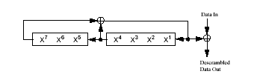
Scrambler
S(x) = x⁷ + x⁴ + 1
Repeats after 127 bits

Slide 40
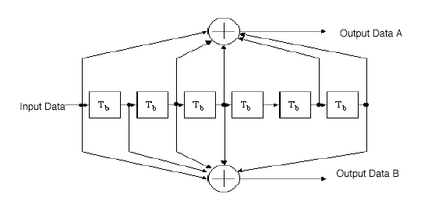
Convolutional encoder
Constraint length = 7
Industry-standard generator polynomials, g₀ = (133)₈ and g₁ = (171)₈

Slide 41
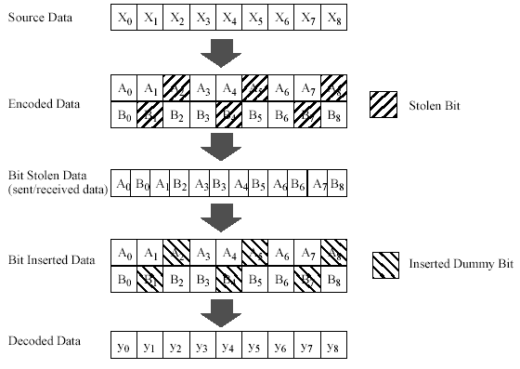
Puncturing – Coding Rate 3/4

Slide 42
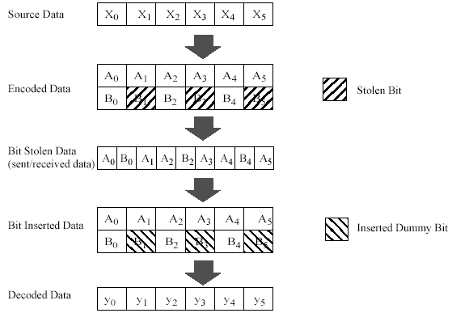
Puncturing – Coding Rate 2/3

Slide 43
Interleaving
First permutation
i = (NCBPS/16) (k mod 16) + floor(k/16)
k = 0,1,…,NCBPS – 1
Second permutation
j = s × floor(i/s) + (i + NCBPS – floor(16 × i/NCBPS)) mod s
i = 0,1,… NCBPS – 1
s = max(NBPSC/2,1)

Slide 44
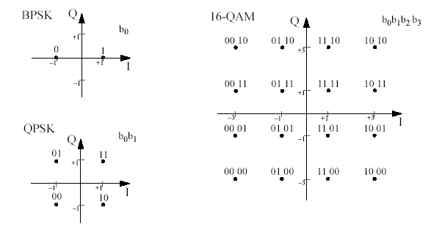
Modulation (Mapping)

Slide 45
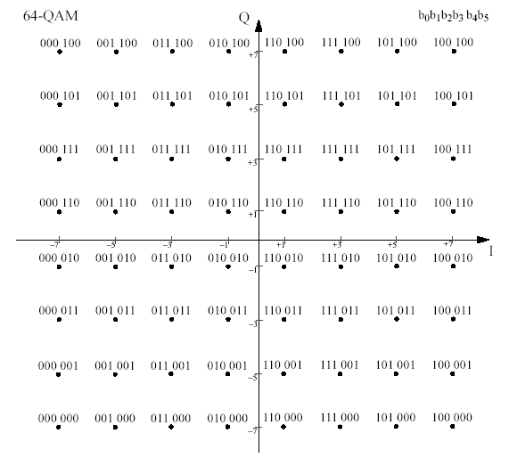
Modulation (Mapping)

Slide 46
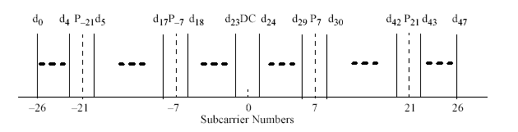
Pilots Insertion

Slide 47
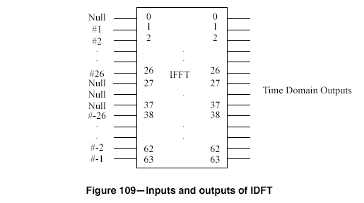
IFFT
52 Data Subcarriers
4 Pilots
64 Point IFFT

Slide 48
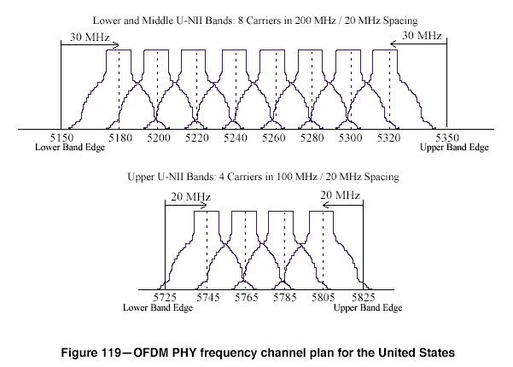
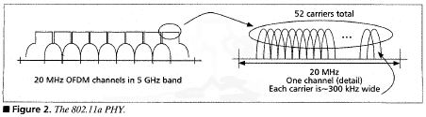
OFDM Frequency Usage

Slide 49
Cyclic Prefix
80 samples OFDM Symbol
64 pt IFFT out
Copy

Slide 50
IQ Modulation
Sin(w_{c}t)
I
Output
Q
Cos(w_{c}t)

Slide 51
802.11b
PHYSICAL LAYER

Slide 52
FHSS
Frequency Hopping Spread Spectrum
1 and 2 Mbps
Band 2400-2483.5 MHz
GFSK (Gaussian Frequency Shift Keying)
Sub-channels of 1 MHz
Only 79 channels of the 83 are used
Slow hopping ( 2.5 hops per second)
3 main sets each with 26 different hopping sequences

Slide 53
CCK
5.5 and 11 Mbps
Barker sequences spreading
  (3 to 13 bits) with very good autocorrelation properties
Replaced by Complementary Code Keying (CCK)
Eight chips, where each chip is a complex QPSK bit-pair at a chip rate of 11Mchip/s
In 5.5 Mbit/s and 11 Mbit/s modes respectively 4 and 8 bits are modulated onto the eight chips of the symbol c0,...,c7

Slide 54
802.11g

Slide 55
Modulation Scheme
Backward compatible with 802.11b
OFDM when operating independently
CCK when operating with 802.11b nodes

Slide 56
Extended Features
RTS to self
Flexible Modulation schemes

Slide 57
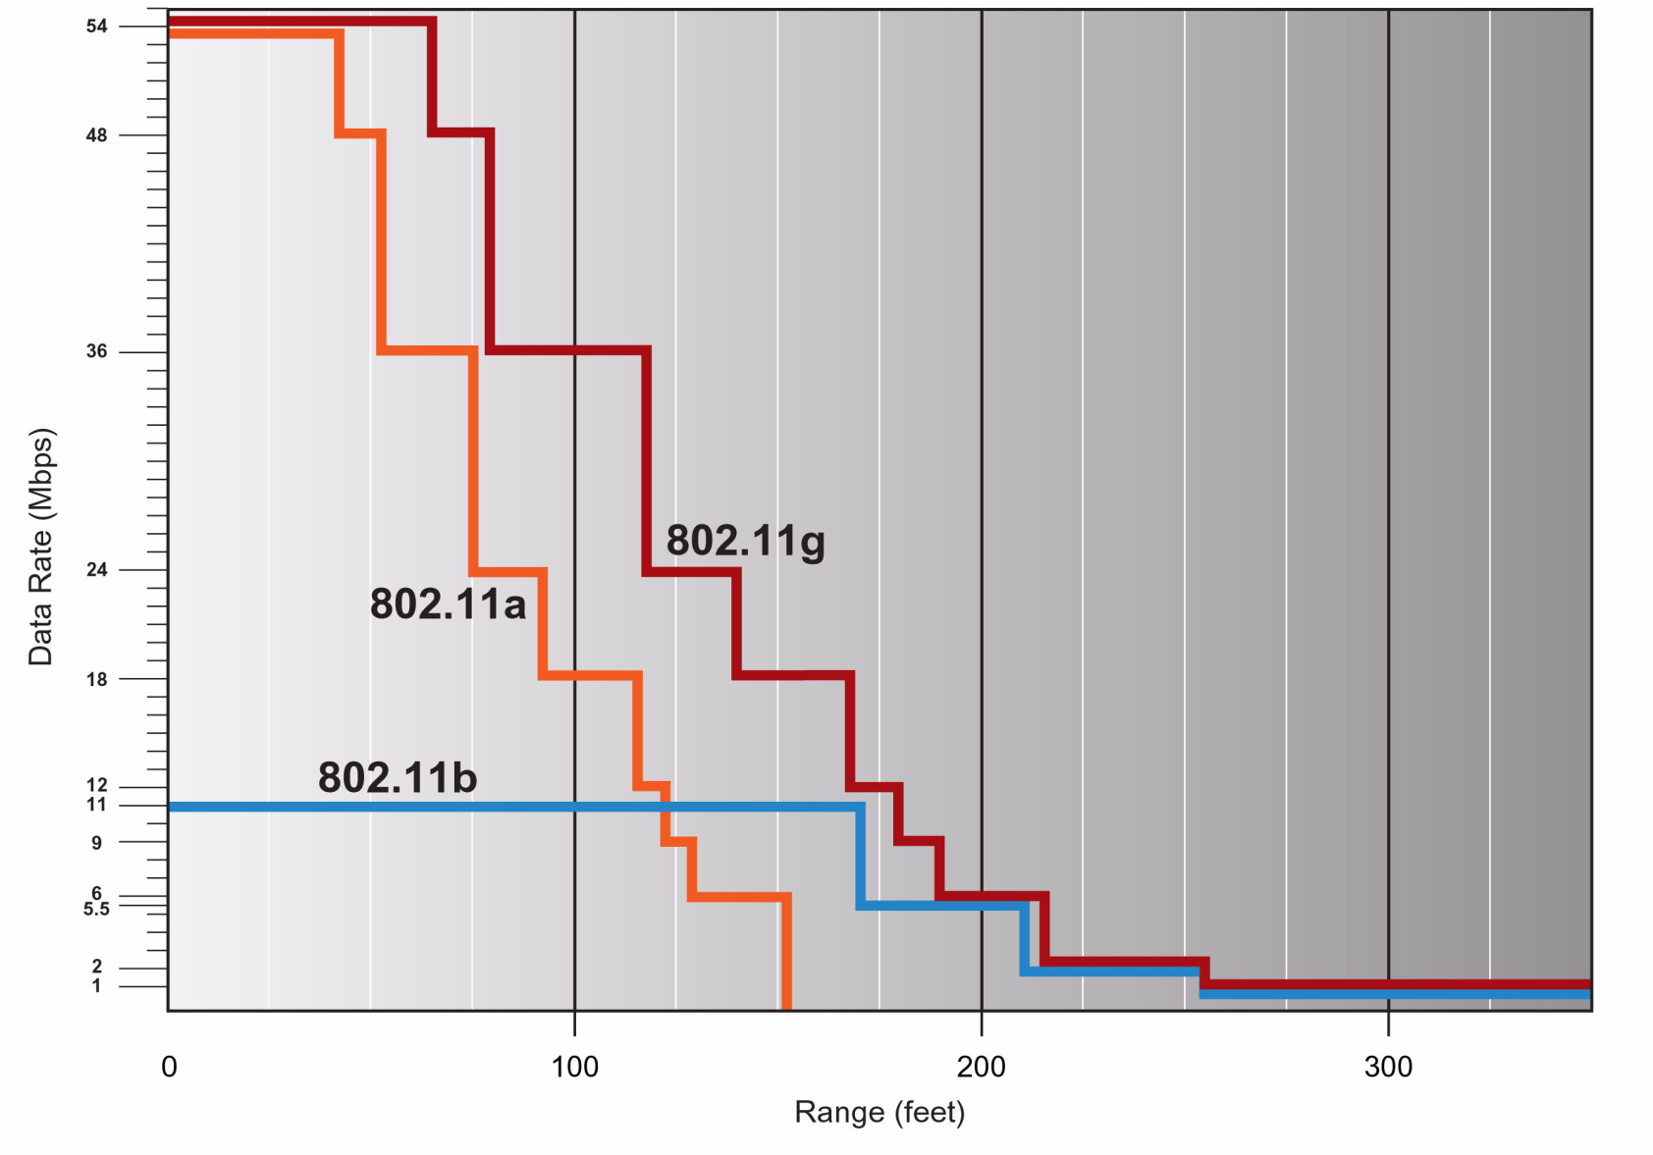
Comparison

